Slide 1
High-resolution image reconstruction with latent diffusion models from human brain activity
2021311097
Myeonggyo Jeong

Slide 2
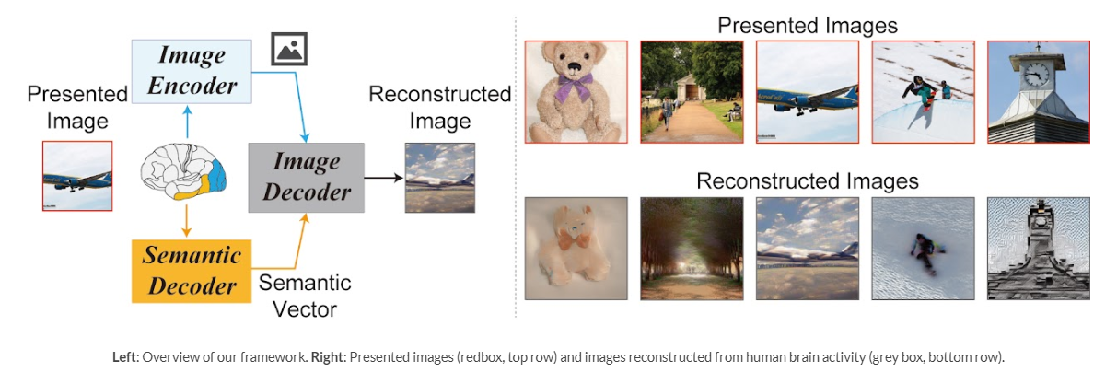
Introduction
Decoding
Encoding
Results
Overview
Aims
Reconstructing visual experiences from human brain activity offers a unique way to understand how the brain represents the world, and to interpret the connection between computer vision models and our visual system.
reconstructing realistic images with high semantic fidelity is still a challenging problem
A new model based on a diffusion model to reconstruct images from brain activity via fMRI

Slide 3
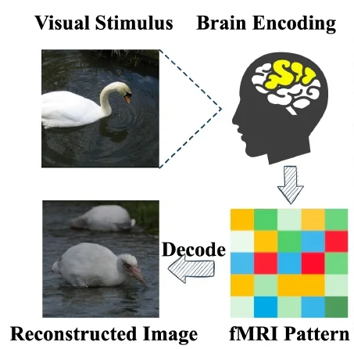
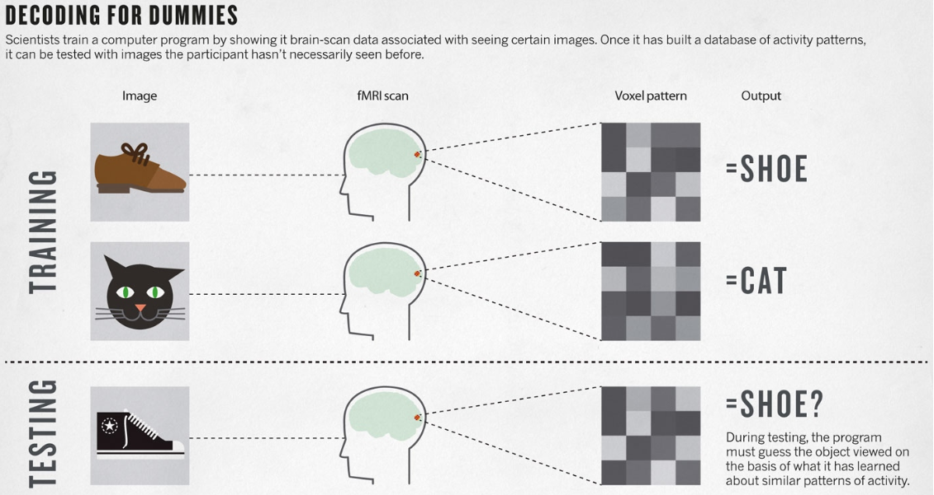
Introduction
Decoding
Encoding
Results
Prerequisites

Slide 4
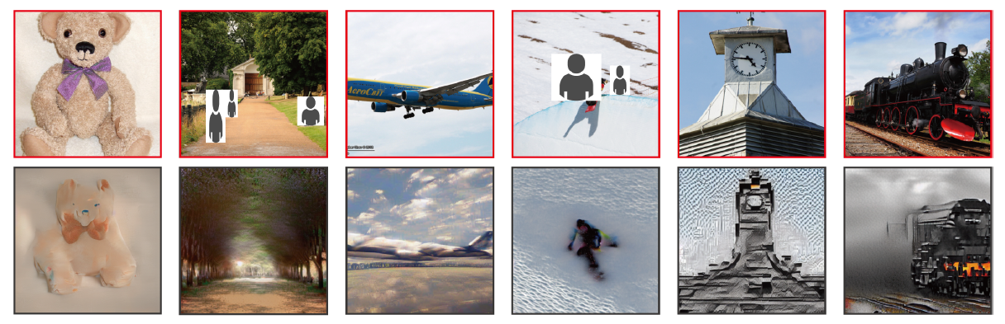
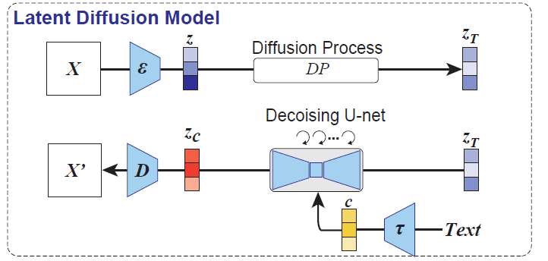
Introduction
Decoding
Encoding
Results
Contributions
(i) Demonstrate that framework can reconstruct high-resolution (512 X 512) images from brain activity with high semantic fidelity,
without the need for training or fine-tuning of deep generative models
(ii) Quantitatively interpret each component of an LDM from a neuroscience perspective, by mapping specific components to distinct brain regions

Slide 5
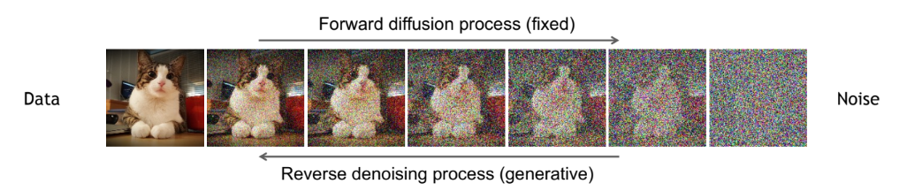
Introduction
Decoding
Encoding
Results
What is ‘Diffusion Model’?
Forward diffusion process that gradually adds noise to input
Reverse denoising process that learns to generate data by denoising

Slide 6
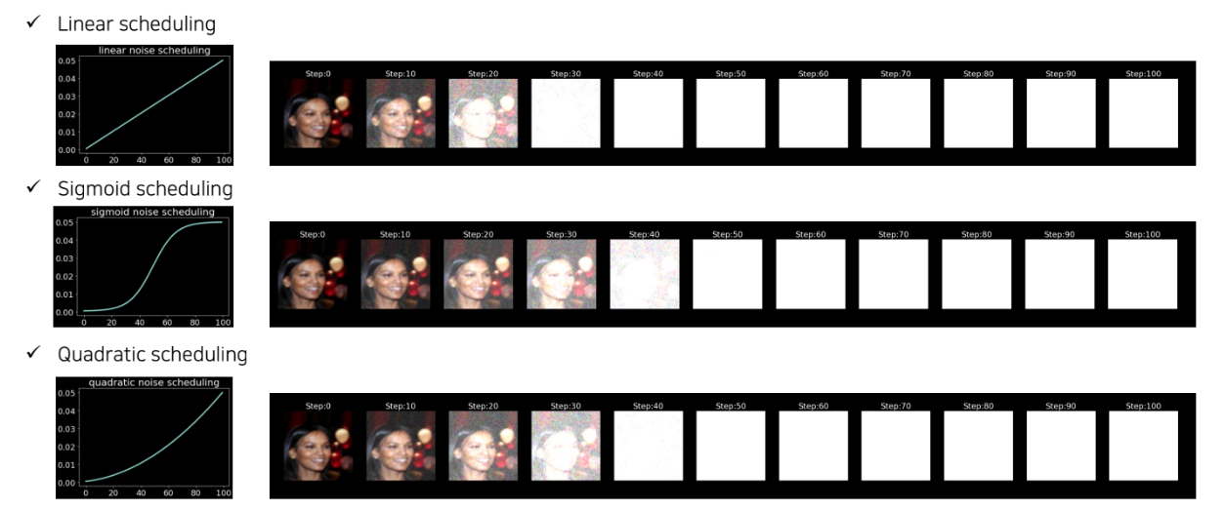
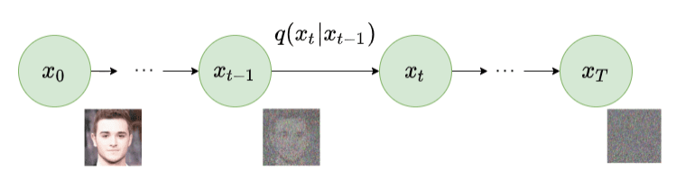
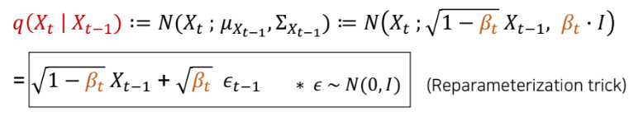
Introduction
Decoding
Encoding
Results
What is ‘Diffusion Model’?
Forward Diffusion
Amount of noise injected
Forward : image is corrupted by gradually adding noise until image becomes complete random noise

Slide 7
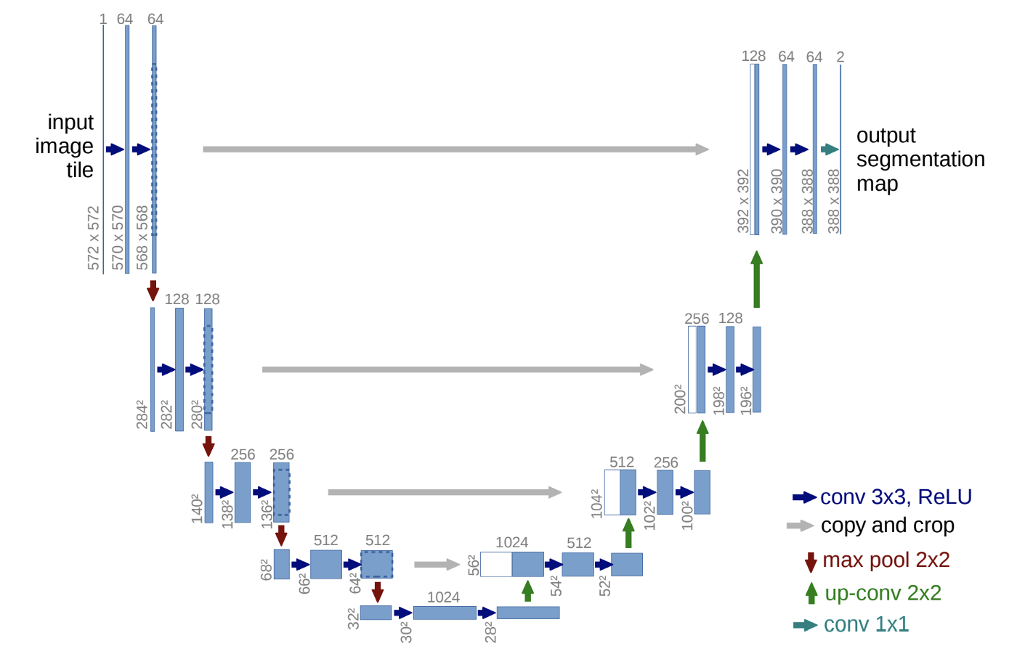
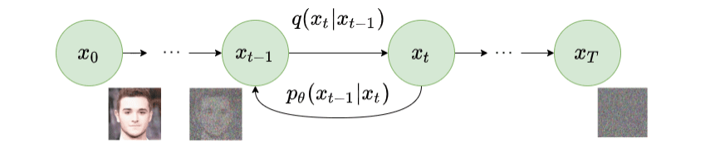
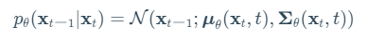
Introduction
Decoding
Encoding
Results
What is ‘Diffusion Model’?
Reverse Diffusion
approximate with a parameterized model : U-Net
Reverse : a series of Markov Chains are used to recover the data from the Gaussian noise
by gradually removing the predicted noise at each time step.

Slide 8
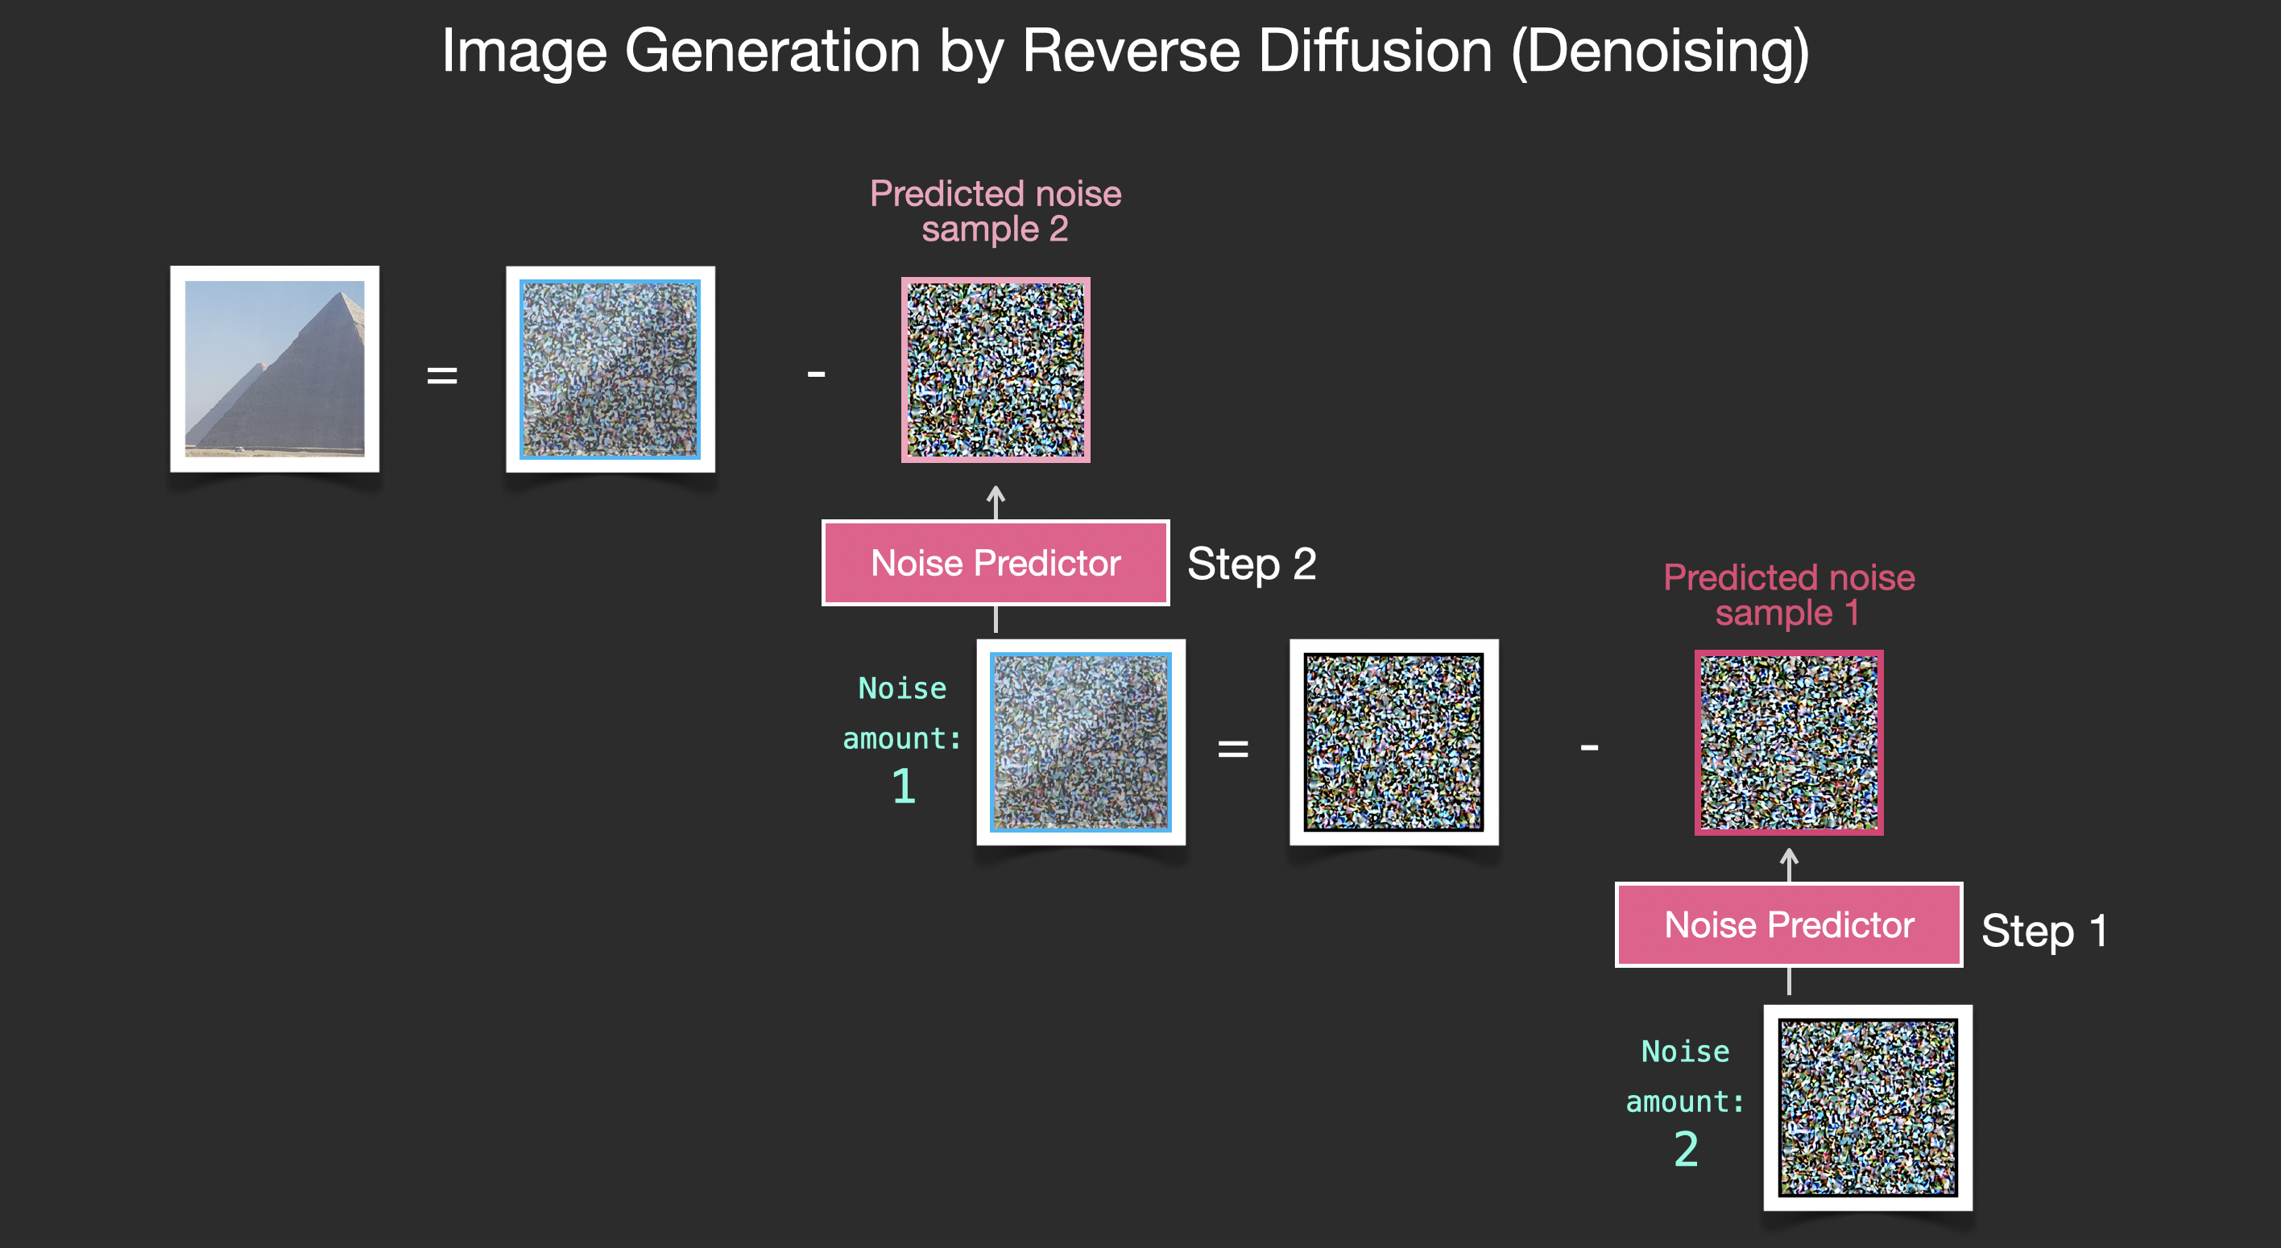
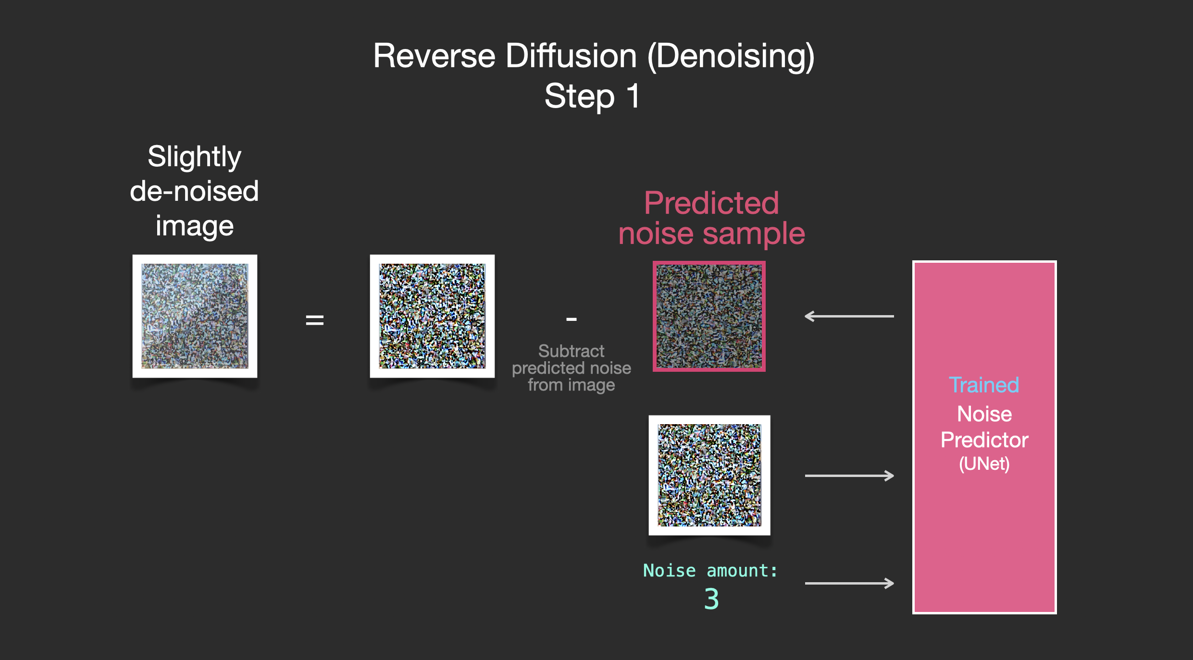
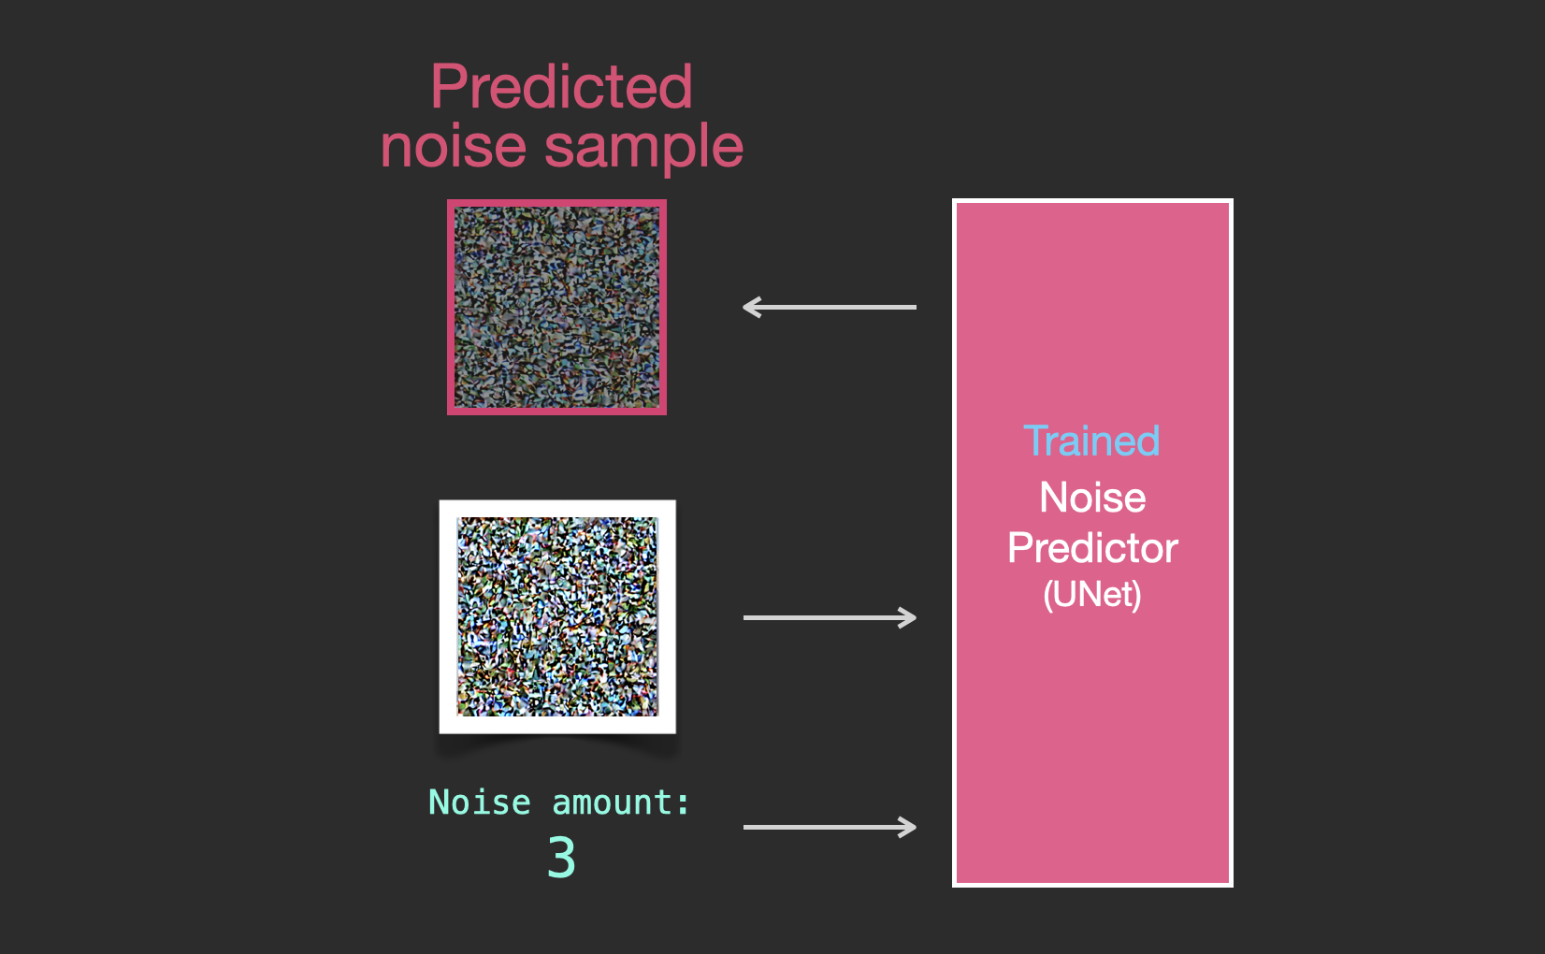
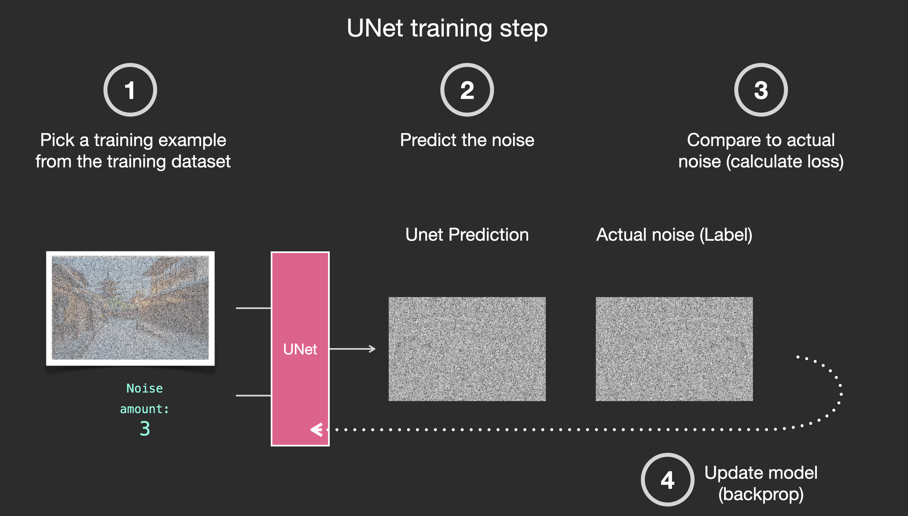
Introduction
Decoding
Encoding
Results
U-Net training step

Slide 9
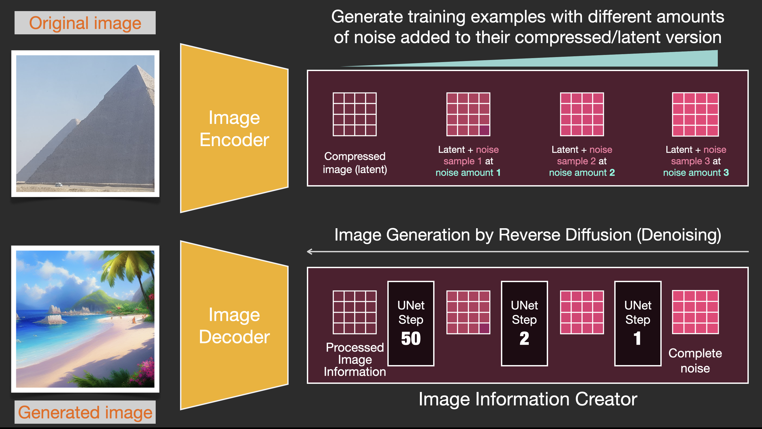
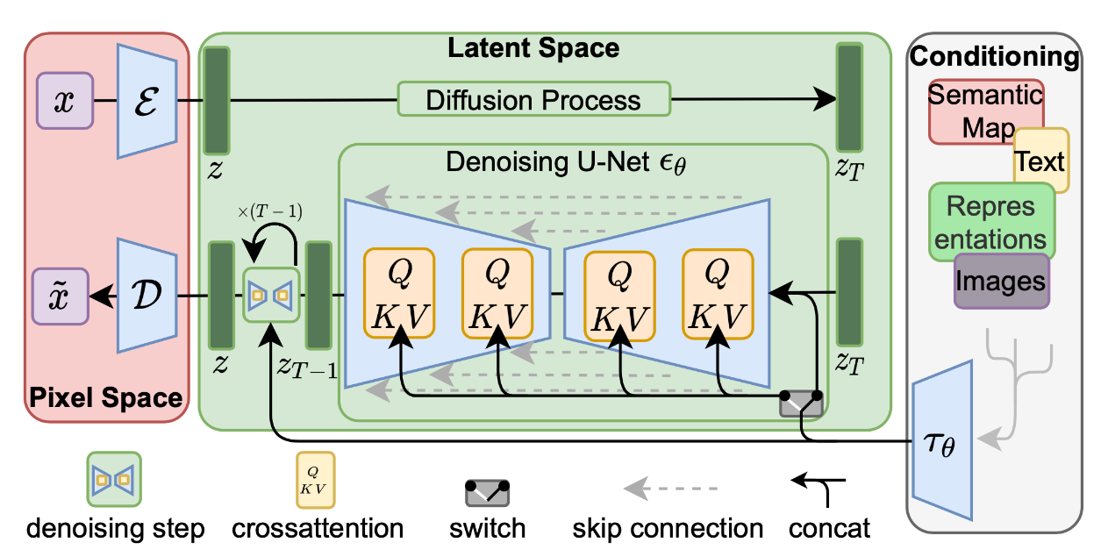
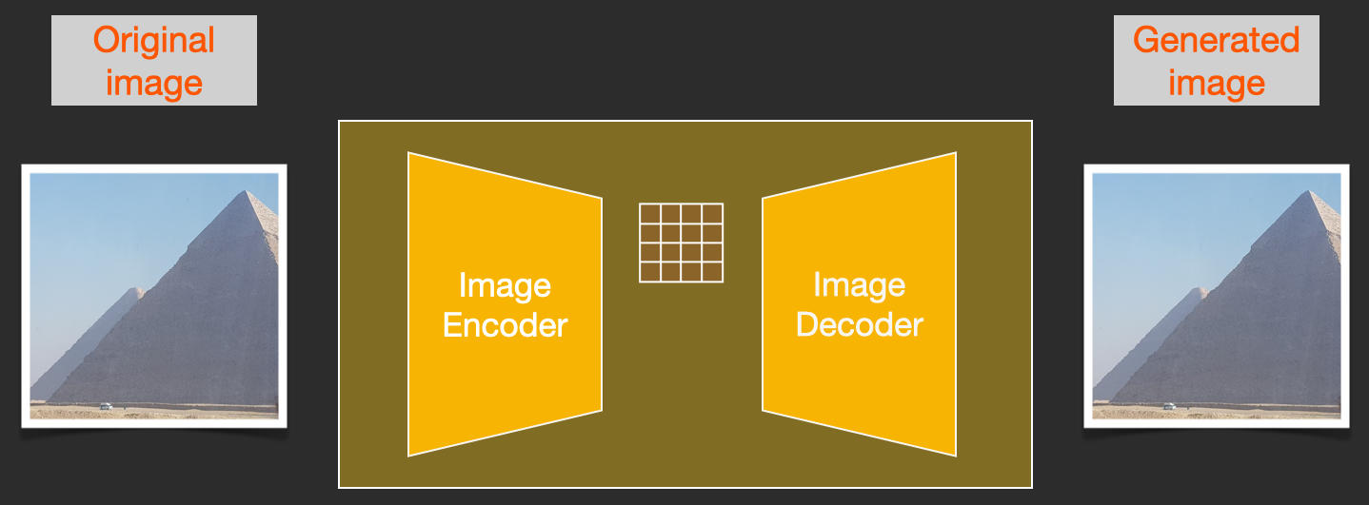
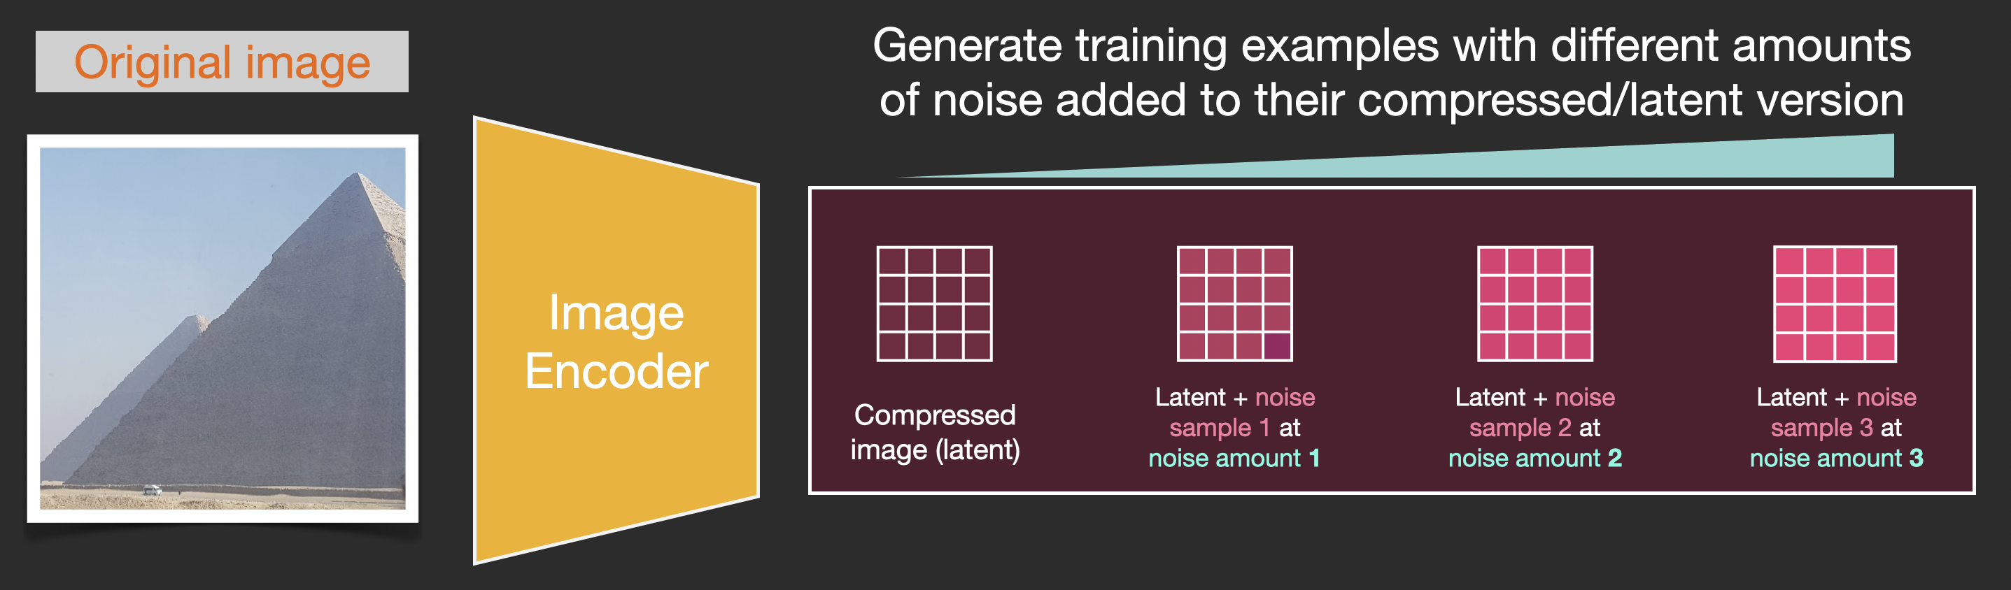
Introduction
Decoding
Encoding
Results
What is ‘Latent (Stable) Diffusion Model’?
Stable Diffusion paper runs the diffusion process not on the pixel images,
but on a compressed version of the image.

Slide 10
Introduction
Decoding
Encoding
Results
Latent Diffusion Model
image encoder
image decoder
Schematic of LDM
text encoder (CLIP)

Slide 11
Introduction
Decoding
Encoding
Results
Latent Diffusion Model
Z : latent representation of the original image compressed by the autoencoder
C : latent representation of texts
Zc : generated latent representation of modified by the model with c

Slide 12
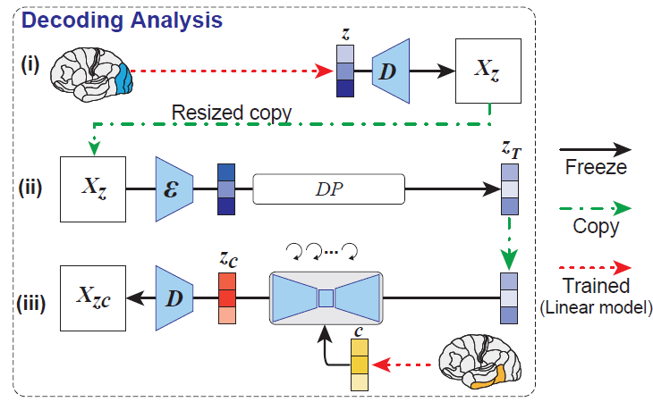
Introduction
Decoding
Encoding
Results
Decoding : reconstructing images from fMRI
(i) latent representation of the z presented image X from fMRI signals within
early visual cortex --> produce coarse decoded images Xz
(ii) add noise to Xz through the diffusion process
(iii) decode latent text representations c from fMRI signals within
higher (ventral) visual cortex
The only training required is to construct linear models that map fMRI signals to each LDM component
L2-regularized linear regression

Slide 13
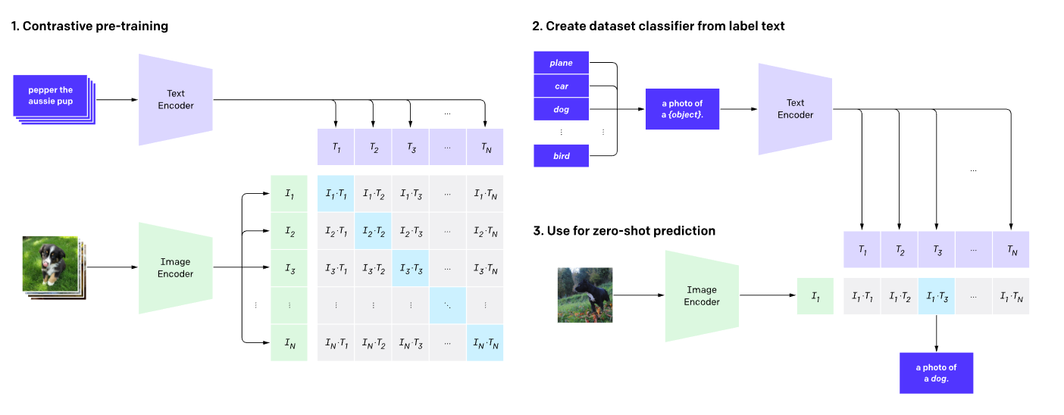
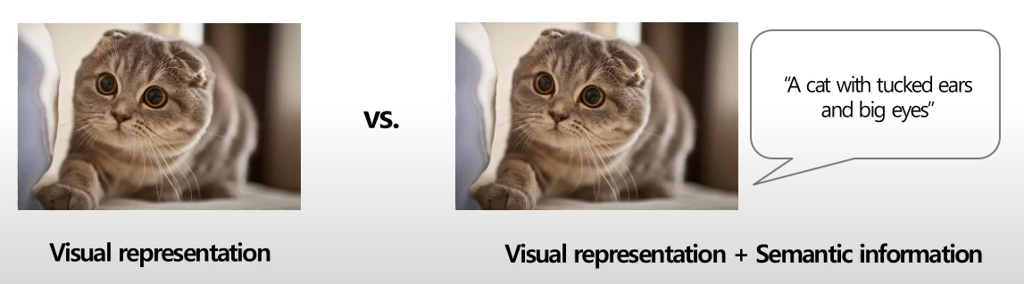
Introduction
Decoding
Encoding
Results
Then, what is the ‘CLIP’?
Using Image – Text pair
CLIP is an open source, multi-modal, zero-shot model. Given an image and text descriptions, the model can predict the most relevant text description for that image, without optimizing for a particular task.

Slide 14
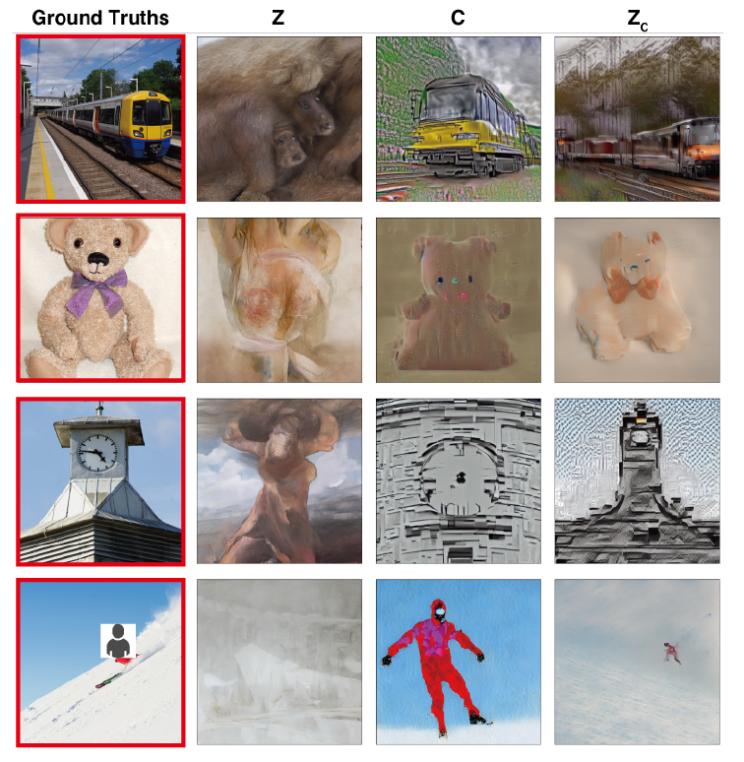
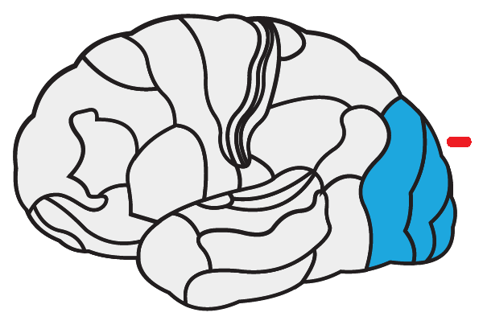
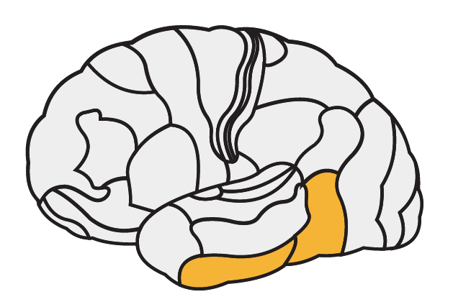
Introduction
Decoding
Encoding
Results
Decoding Results
Z : images reconstructed using only z were visually consistent with the original
images, but failed to capture their semantic content
C : images reconstructed using only c generated images with high semantic
fidelity but were visually inconsistent.
+
Zc : images reconstructed using Zc could generate high resolution images
with high semantic fidelity
Presented (red box) and reconstructed images using Z, C, and Zc

Slide 15
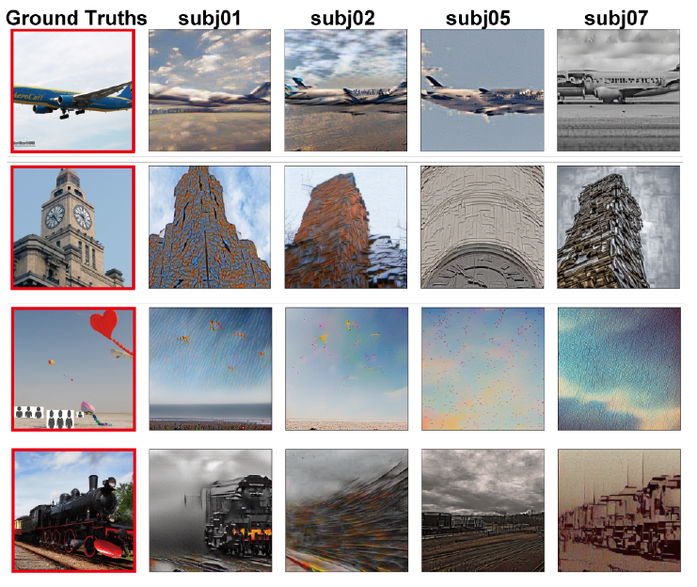
Introduction
Decoding
Encoding
Results
Decoding Results
reconstruction quality was stable and accurate across subjects
Example results for all four subjects using Zc

Slide 16
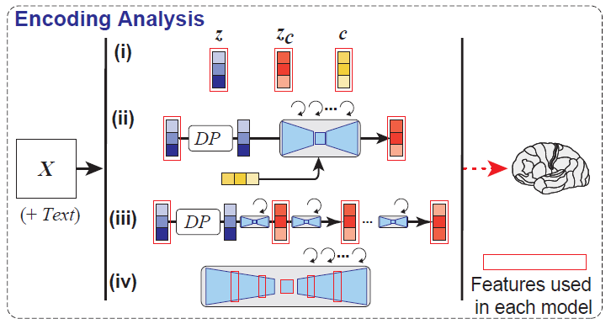
Introduction
Decoding
Encoding
Results
Encoding : Whole-brain Voxel-wise Modeling
to interpret the internal operations of LDMs by mapping them to brain activity
the activation patterns observed within early and late layers of a CNN correspond to the neural activity patterns measured from early and late layers of visual cortex
However, the correspondence between DMs and the brain is less obvious
→ understand the underlying mechanisms of DMs and its correspondence to the brain
Schematic of encoding analysis
encoding models to predict fMRI signals from different
components of LDM, including z, c, and zc

Slide 17
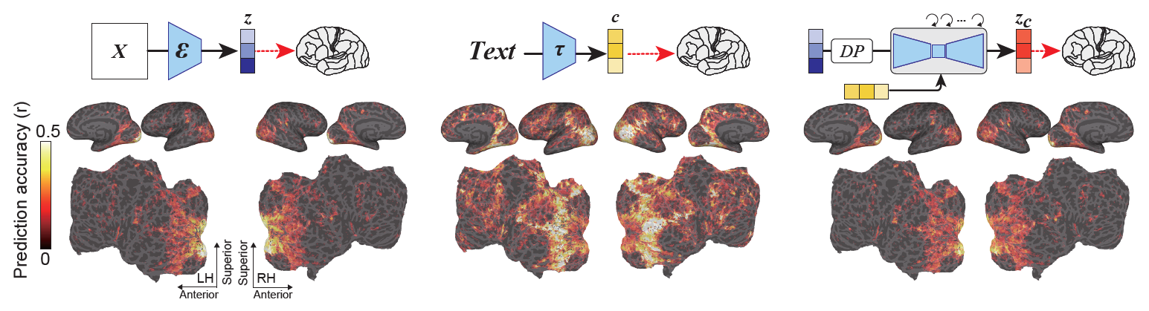
Introduction
Decoding
Encoding
Results
Encoding Model
Comparison among Latent Representations
high prediction performance in the early visual cortex
significant prediction values in the higher visual cortex
the highest prediction performance in the
higher visual cortex
similar to z, showing high prediction performance for
early visual cortex

Slide 18
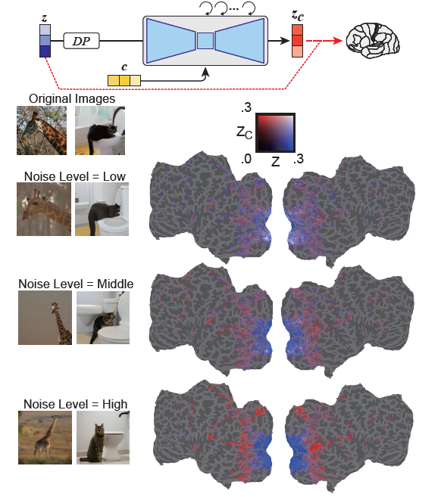
Introduction
Decoding
Encoding
Results
Encoding Model
Comparison among different noise levels
Then, how much unique variance is explained by each feature as
a function of different noise levels in Z and Zc?
: constructed encoding models that simultaneously incorporated both Z and Zc into a single model,
studied the unique contribution of each feature by varying the noise level added to z
Z better
The semantic content of the image
was gradually emphasized
Zc better

Slide 19
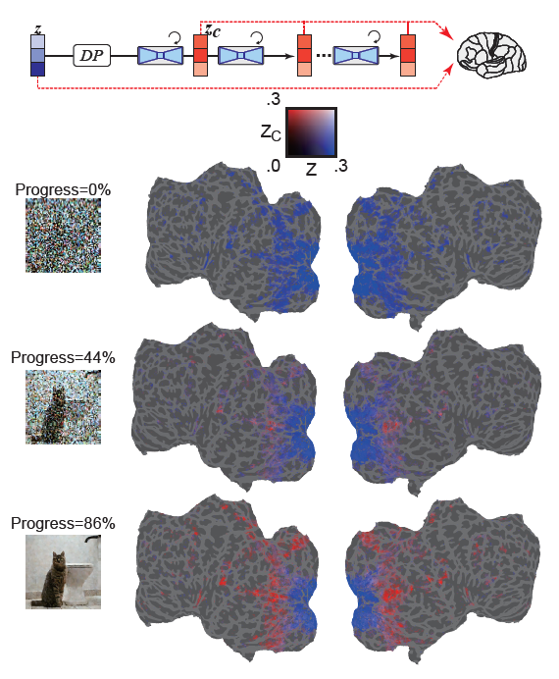
Introduction
Decoding
Encoding
Results
Encoding Model
Comparison across different diffusion stages
Then, how the noise-added latent representation changes over the iterative denoising process?
: during the early stages of the denoising process, Z signals dominated prediction of fMRI signals
: during the middle stages, Zc predicted activity within higher visual cortex much better than z
the bulk of the semantic content emerges at this stage

Slide 20
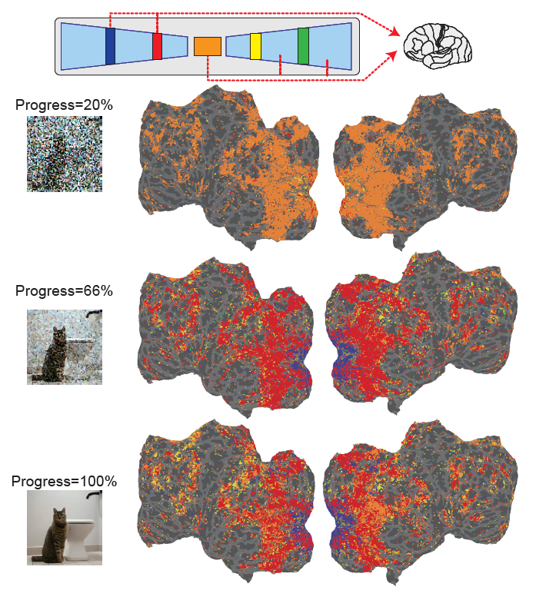
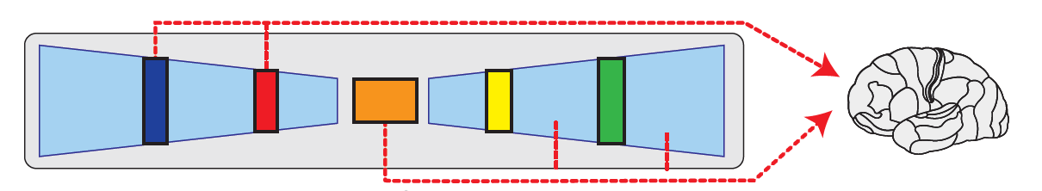
Introduction
Decoding
Encoding
Results
Encoding Model
Comparison across different U-Net Layers
Finally, what information is being processed at each layer of U-Net?
: During the early phase of the denoising process, the bottleneck layer of U-Net (colored
orange) produces the highest prediction performance across cortex
At the beginning of the reverse diffusion, information is compressed within
Bottleneck layer
fine-scale details in early visual areas
higher-order information in more ventral, semantic areas
: As denoising progresses, the early layer of U-Net (colored blue) predicts activity within early visual cortex, the bottleneck layer shifts toward superior predictive power for higher visual cortex.
As denoising progresses, a functional dissociation among U-Net emerges

Slide 21
Introduction
Decoding
Encoding
Results
Conclusion
- can reconstruct high resolution images with high semantic fidelity from human brain activity
- provide a quantitative interpretation for the internal components of the LDM by building encoding models

Slide 22


